Slide 1
Python HandsOn

Slide 2
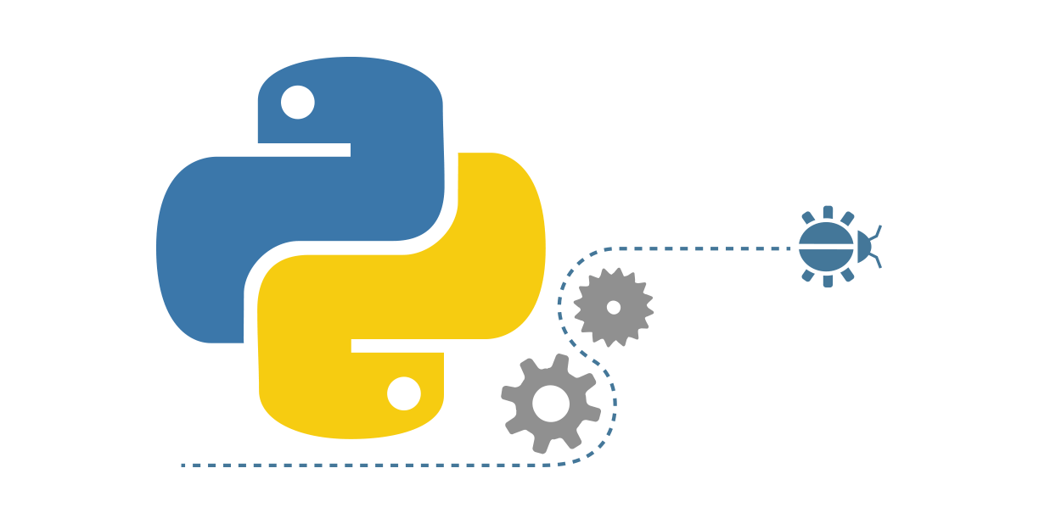
Agenda
Basic Script
Primitive Data Structures
Control Flow Tools
Non-Primitive Data Structures
Functions
Method Types
Notes:
To understand this, let’s take a scenario.

Slide 3
Basic Script

Slide 4
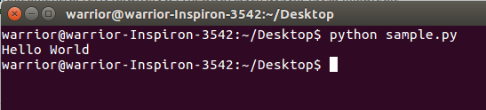
Python - Basic Script
Assuming that sample.py is a python script file existed in your PC.
Content of sample.py are: print “Hello, Python”
When we run the file with command: python sample.py, the output is: Hello, Python

Slide 5
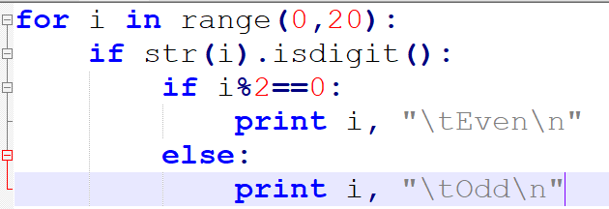
Lines and indentation
Python provides no braces to indicate blocks of code for class and function definitions or flow control.
Blocks of code are denoted by line indentation, which is rigidly enforced.
Notes:
To understand this, let’s take a scenario.

Slide 6
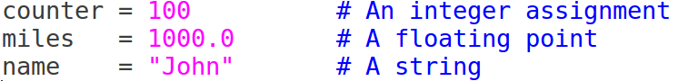
Assigning Values to Variables
Python variables do not need explicit declaration to reserve memory space.
The declaration happens automatically when you assign a value to a variable.
The equal sign (=) is used to assign values to variables.
For example:

Slide 7
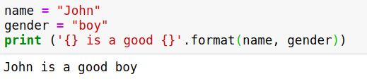
format operator
The string format() method formats the given string into a nicer output in Python.
For example:

Slide 8
Primitive Data Structures

Slide 9
Agenda
Integer
Float
Strings
Boolean

Slide 10
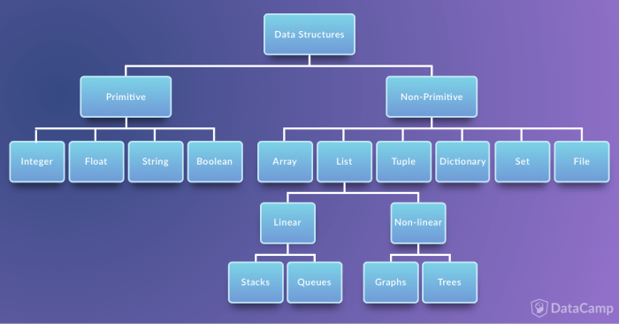

Slide 11
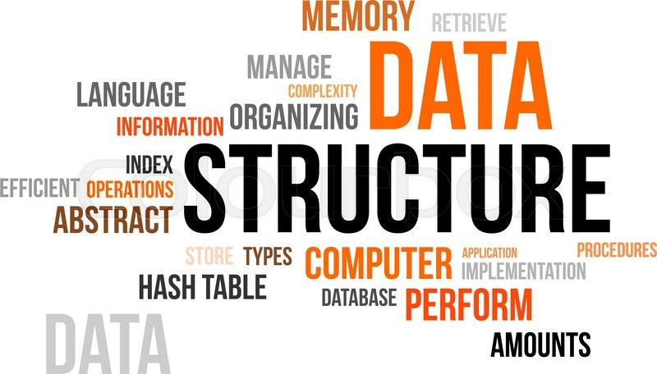
Primitive Data Structures
These are the most primitive or the basic data structures. They are the building blocks for data manipulation and contain pure, simple values of a data. Python has four primitive variable types:
Integers
Float
Strings
Boolean

Slide 12
Integer and Float

Slide 13
Integer and Float
In Python, you can use an integer represent numeric data, and more specifically, whole numbers from negative infinity to infinity, like 4, 5, or -1.
"Float" stands for 'floating point number'. You can use it for rational numbers, usually ending with a decimal figure, such as 1.11 or 3.14.
Notes:
To understand this, let’s take a scenario.

Slide 14
Python is Dynamically Typed
In Python, you do not have to explicitly state the type of the variable or your data. That is because it is a dynamically typed language.
Dynamically typed languages are the languages where the type of data an object can store is mutable.
That is, you need not explicitly state that a value is an integer. The typing is allotted automatically by python.
Notes:
http://techtales.co/2017/09/05/dynamic-typing-vs-static-typing-mean/

Slide 15
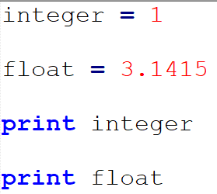
Integer and Float
Assigning a value (either integer or float) to a variable in python is relatively easy.
You just have to type the variable name followed by an “=” sign and the value.
For example:
integer = 1
float = 3.1415
The image shows an example of the same.

Slide 16
Strings - Basic Operations

Slide 17
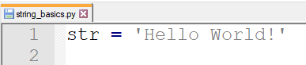
Strings
Strings are collections of alphabets, words or other characters.
In Python, you can create strings by enclosing a sequence of characters within a pair of single or double quotes.
For example: 'cake', "cookie", etc.
Similar to integers, strings can also be assigned by typing the variable name followed by an “=” sign and the value. For example:
str= “Hello World”
Notes:
To understand this, let’s take a scenario.

Slide 18
String Indexing
Similar to lists, string indexing always starts from zero.
For example, in the string “HELLO”, The indexing would be as follows:
So, when you give the command to print the 4th character (that is, ‘O’), it should look like:
print str[4]
0 | 1 | 2 | 3 | 4
H | E | L | L | O
Notes:
One way to remember how slices work is to think of the indices as pointing between characters, with the left edge of the first character numbered 0. Then the right edge of the last character of a string of n characters has index n. for example:
+---+---+---+---+---+---+ | P | y | t | h | o | n | +---+---+---+---+---+---+ 0 1 2 3 4 5 6 -6 -5 -4 -3 -2 -1

Slide 19
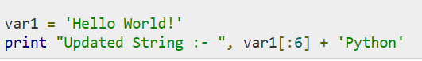
Updating Strings
You can "update" an existing string by (re)assigning a variable to another string.
The new value can be related to its previous value or to a completely different string altogether. A good example would be as shown above.
When the above code is executed, it produces the following result:
Updated String :- Hello Python
Notes:
One way to remember how slices work is to think of the indices as pointing between characters, with the left edge of the first character numbered 0. Then the right edge of the last character of a string of n characters has index n. for example:
+---+---+---+---+---+---+ | P | y | t | h | o | n | +---+---+---+---+---+---+ 0 1 2 3 4 5 6 -6 -5 -4 -3 -2 -1

Slide 20
Accessing String Subsets
You can also slice strings, which means that you select parts of strings.
Subsets of strings can be taken using the slice operator ([ ] and [:] ) with indexes starting at 0 in the beginning of the string and working their way from -1 at the end.
For example, if you want to print the 3rd to 5th characters in the string, the command would be:
print str[2:5]

Slide 21
Accessing String Subsets
If you want to print the string starting from the 3rd character, the command would be:
print str[2:]

Slide 22
String Concatenation
String concatenation (adding two strings) is quite simple.
You can apply the + operations on two or more strings to concatenate them, just like in the example shown.
The output would print: Hello World!TEST

Slide 23
String Repetition
You can use * to repeat a string a certain number of times.
For example, to print the string “Hello World!” two times, you can use the command:
print str * 2

Slide 24
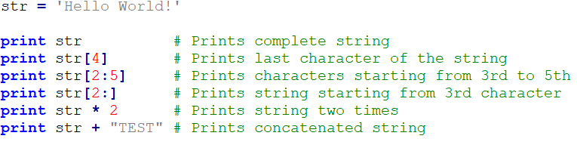
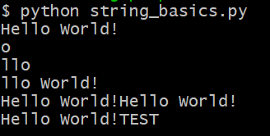
Summary: Basic String Operations
Here’s a summarized version of all the basic string operations discussed till now.
This will produce the following result:

Slide 25
String Formatting

Slide 26
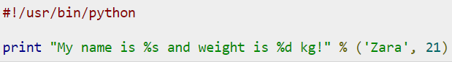
String Formatting
One of Python's coolest features is the string format operator %.
This operator is unique to strings and makes up for the pack of having functions from C's printf() family.
Shown above, is a simple example and when executed, it produces the following result:
My name is Zara and weight is 21 kg!
Notes:
To understand this, let’s take a scenario.

Slide 27
String Formatting
Here is the list of most common set of symbols which can be used along with %
Format Symbol | Conversion
%c | character
%s | string conversion via str() prior to formatting
%d | signed decimal integer
%o | octal integer
%x | hexadecimal integer (lowercase letters)
%X | hexadecimal integer (UPPERcase letters)
%f | floating point real number
Notes:
To understand this, let’s take a scenario.

Slide 28
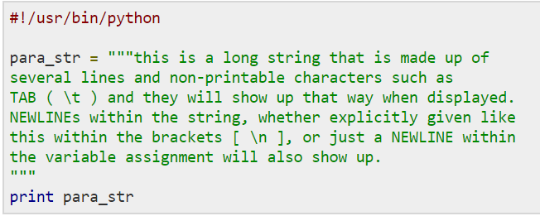
Triple Quotes
Python triple quotes comes to the rescue by allowing strings to span multiple lines, including verbatim NEWLINEs, TABs, and any other special characters.
The syntax for triple quotes consists of three consecutive single or double quotes.

Slide 29
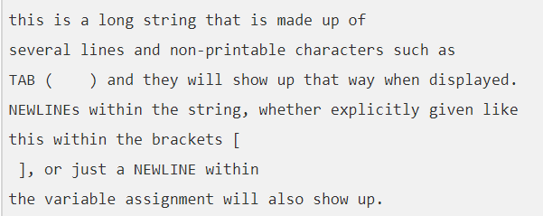
Triple Quotes
When the above code is executed, it produces the result as shown.
Note how every single special character has been converted to its printed form, right down to the last NEWLINE at the end of the string between the "up." and closing triple quotes.
Also note that NEWLINEs occur either with an explicit carriage return at the end of a line or its escape code (\n)

Slide 30
Strings: Built-In methods Operations

Slide 31
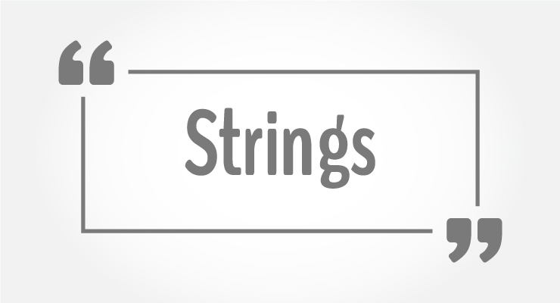
Strings: Built-In methods Operations
Python has many built-in methods or helper functions to manipulate strings.
Replacing a substring, capitalising certain words in a paragraph, finding the position of a string within another string are some common string manipulations.
Notes:
To understand this, let’s take a scenario.

Slide 32
String Operations: Built-In methods
Method | Basic Usage | Description
capitalize() | str.capitalize('cookie') | Capitalizes first letter of string
count() | count(str, beg= 0,end=len(string)) | Counts how many times str occurs in string or in a substring of string if starting index beg and ending index end are given.
len() | len(str1) | Retrieve the length of a string in characters. Note that the spaces also count towards the final result
find() | str1.find(str2) | Find substrings in other strings; Returns the lowest index or position within the string at which the substring is found
Notes:
To understand this, let’s take a scenario.

Slide 33
String Operations: Built-In methods
Method | Basic Usage | Description
isalnum() | str.isalnum(‘a1pha num3ric’) | checks whether the string consists of alphanumeric characters.
isalpha() | str.isalpha(‘alphabets’) | checks whether the string consists of alphabetic characters only
isdigit() | str1.isdigit() | Check whether a string consists of only digits
split() | split(str="", num=string.count(str)) | Splits string according to delimiter str (space if not provided) and returns list of substrings
replace() | str1.replace('4 U', str2) | Replace parts of strings with other strings
Notes:
To understand this, let’s take a scenario.

Slide 34
Summary: Built-In String Operations
Here’s a summarized version of all the basic string operations discussed till now.
str1 = "hello World"
str2 = "a1pha num3ric"
str3 = "123456"
print "\n"
print str1.capitalize()
print "str1.count('o', 1, len(str1)):\t", str1.count('o', 1, len(str1)),"\n"
print "isalpha(str1):\t", str1.isalpha()
print "isdigit(str3):\t", str3.isdigit()
print "isalnum(str2):\t", str2.isalnum()
print "split(str2):\t", str2.split()
print "str1.replace('o', str3):\t", str1.replace('o', str3)

Slide 35
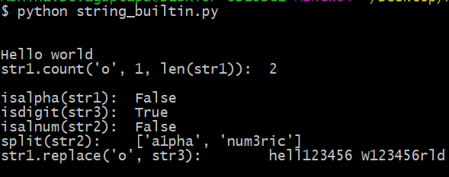
Summary: Built-In String Operations
When executed, the program output will be as shown.

Slide 36
Boolean

Slide 37
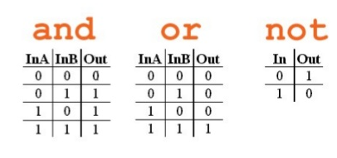
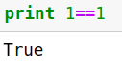
Boolean
This built-in data type that can take up the values: True and False, which often makes them interchangeable with the integers 1 and 0.
Above shown are the truth tables for and, or and not
Notes:
Booleans are operators that allow you to convey True or False statements.
If you type the code “1==1”, and execute, it returns “True”

Slide 38
Boolean
Booleans are useful in conditional and comparison expressions (if - else statements), just like in the following examples:
Assuming that x = 4 and y = 2:
Example condition | Boolean value
x == y (x is equal to y) | False
x <y (x is lesser than y) | False
x > y (x is greater than y) | True
x != y (x is not equal to y) | True

Slide 39
Control Flow Tools

Slide 40
Agenda
Decision Making
If statements
if… else statements
if… elif… else statements
nested if… else statements
Loops
Loop Control
Break, pass and continue statements
while loop
for loop
nested loops

Slide 41
Decision Making

Slide 42
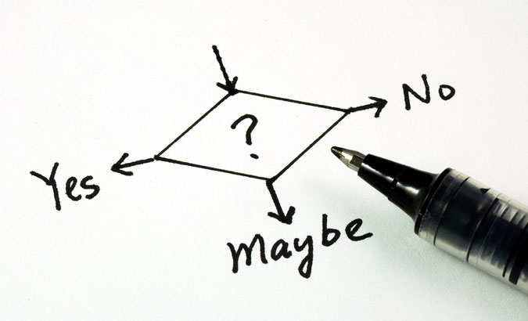
Decision Making
Anticipation of conditions occurring while execution of the program and specifying actions taken according to the conditions
Decision structures evaluate multiple expressions which produce TRUE or FALSE as outcome.
You need to determine which action to take and which statements to execute if outcome is TRUE or FALSE otherwise.

Slide 43
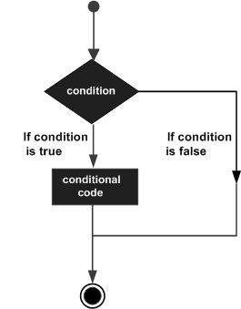
Decision Making
Here is the general form of a typical decision making structure found in most of the programming languages.
Python programming language assumes any non-zero and non-null values as TRUE, and if it is either zero or null, then it is assumed as FALSE value.
Notes:
To understand this, let’s take a scenario.

Slide 44
Decision making statements in Python
Python programming language provides following types of decision making statements.
Statement | Description
if statements | An if statement consists of a boolean expression followed by one or more statements.
if… else statements | An if statement can be followed by an optional else statement, which executes when the boolean expression is FALSE.
nested if statements | You can use one if or else if statement inside another if or else if statement(s).
Notes:
http://techtales.co/2017/09/05/dynamic-typing-vs-static-typing-mean/

Slide 45
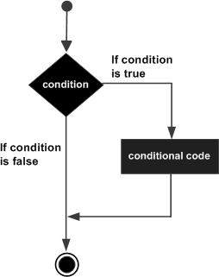
if Statements
The if statement contains a logical expression using which data is compared and a decision is made based on the result of the comparison.
If the condition ends up being TRUE, the statement inside the if statement is executed, if it is FALSE, then the first set of code after the end of the if statement(s) is executed.
Notes:
To understand this, let’s take a scenario.

Slide 46
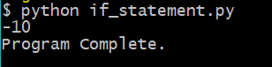
if Statements
For example:
digit_1=10
digit_2=20
if (digit_1 < digit_2):
print (digit_1 - digit2)
print (“Program Complete”)
Note that, the subtracted value will only be printed if the condition digit_1 > digit_2 is true.
Notes:
To understand this, let’s take a scenario.

Slide 47
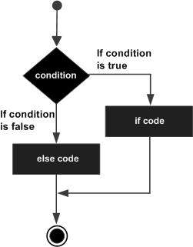
if… else Statements
The "else condition" is usually used when you have to judge one statement on the basis of other.
If one condition goes wrong, then there should be another condition that should justify the statement or logic.
There could be at most only one else statement following if.
Notes:
To understand this, let’s take a scenario.

Slide 48
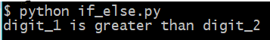
if… else Statements
For example:
digit_1=8
digit_2=4
if(digit_1 < y):
statement= "digit_1 is less than digit_2"
else:
statement= "digit_1 is greater than digit_2"
print (statement)
Based on the condition which holds true, the output would vary.
Notes:
To understand this, let’s take a scenario.

Slide 49
if… elif...else Statements
The elif statement allows you to check multiple expressions for TRUE and execute a block of code as soon as one of the conditions evaluates to TRUE.
There can be any number of elif statements between an if and else statement.
Notes:
To understand this, let’s take a scenario.

Slide 50
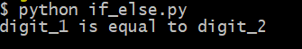
if… elif...else Statements
For example:
digit_1=8
digit_2=8
if(x < y):
statement= "x is less than y"
elif (x == y):
statement= "x is equal to y"
else:
statement= "x is greater than y"
print (statement)
Based on the condition which holds true, the output would vary.
Notes:
To understand this, let’s take a scenario.

Slide 51
Nested if...else Statements
TBy using "elif" condition, you are telling the program to print out the third condition or possibility when the other condition goes wrong or incorrect.
Notes:
To understand this, let’s take a scenario.

Slide 52
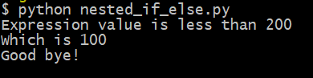
Nested if...else Statements
For example:
variable = 100
if variable < 200:
print "Expression value is less than 200"
if variable == 150:
print "Which is 150"
elif variable == 100:
print "Which is 100"
elif variable == 50:
print "Which is 50"
elif variable < 50:
print "Expression value is less than 50"
else:
print "Could not find true expression"
print "Good bye!"
Based on the condition which holds true, the output would vary.

Slide 53
Loops

Slide 54
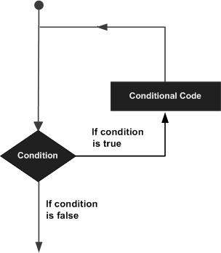
Loops
Loops are important in Python or in any other programming language as they help you to execute a block of code repeatedly.
You will often come face to face with situations where you would need to use a piece of code over and over but you don't want to write the same line of code multiple times.
A loop statement allows us to do exactly the same.
Notes:
To understand this, let’s take a scenario.

Slide 55
Loop types in Python
Python programming language provides following types of loop control statements.
Loop Type | Description
While loop | Repeats a statement or group of statements while a given condition is TRUE. It tests the condition before executing the loop body.
For loop | Executes a sequence of statements multiple times and abbreviates the code that manages the loop variable.
Nested loops | You can use one or more loop inside any another while, for or do..while loop.
Notes:
http://techtales.co/2017/09/05/dynamic-typing-vs-static-typing-mean/

Slide 56
Loop Control Statements in Python
Loop control statements change execution from its normal sequence. When execution leaves a scope, all automatic objects that were created in that scope are destroyed.
Statement | Description
break | Terminates the loop statement and transfers execution to the statement immediately following the loop.
continue | Causes the loop to skip the remainder of its body and immediately retest its condition prior to reiterating.
pass | The pass statement in Python is used when a statement is required syntactically but you do not want any command or code to execute.
Notes:
http://techtales.co/2017/09/05/dynamic-typing-vs-static-typing-mean/

Slide 57
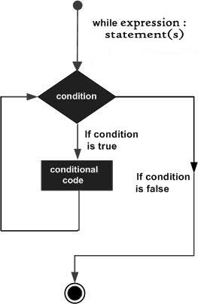
While Loop.
A while loop is a programming concept that, when it's implemented, executes a piece of code over and over again while a given condition still holds true.
The above definition also highlights the three components that you need to construct the while loop in Python:
The while keyword;
A condition that translates to either True or False; And
A block of code that you want to execute repeatedly

Slide 58
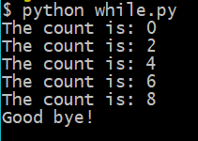
While Loop
For example:
count = 0
while (count < 10):
print 'The count is:', count
#increment the count by 2 every time the loop executes
count = count + 2
print "Good bye!"

Slide 59
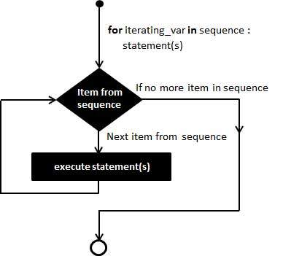
For Loop.
A for loop is similar to a while loop.
The fundamental difference is that the "for" component in "for loop" refers to executing a piece of code over and over again "for" a certain number of times, based on a sequence
The following pieces are needed in order to create a for loop:
The for keyword
A variable
The in keyword
The range() function, which is an built-in function in the Python library to create a sequence of numbers

Slide 60
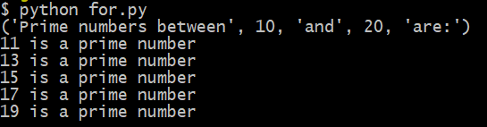
For Loop
For example:
lower = 10
upper = 20
print("Prime numbers between",lower,"and",upper,"are:")
for num in range(lower,upper + 1):
for i in range(2,num):
if (num % i) == 0:
break
else:
print '%d is a prime number \n' %(num),
break

Slide 61
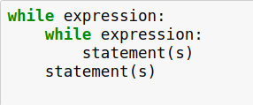
Nested Loops
Python programming language allows to use one loop inside another loop.
The syntax for a nested while loop statement in Python programming language is as follows −
A final note on loop nesting is that you can put any type of loop inside of any other type of loop. For example a for loop can be inside a while loop or vice versa.

Slide 62
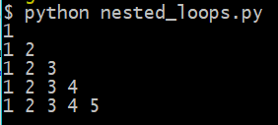
Nested Loops
For example:
number_of_levels=5
for increment in range(1,number_of_levels+1):
for internal_increment in range(1,increment+1):
print internal_increment,
print

Slide 63
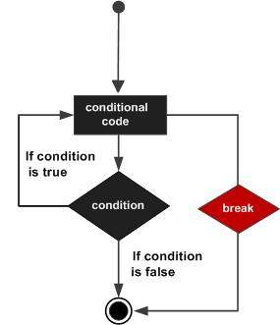
Loop Control: Break
It terminates the current loop and resumes execution at the next statement, just like the traditional break statement in C.
The break statement can be used in both while and for loops.
If you are using nested loops, the break statement stops the execution of the innermost loop and start executing the next line of code after the block.

Slide 64
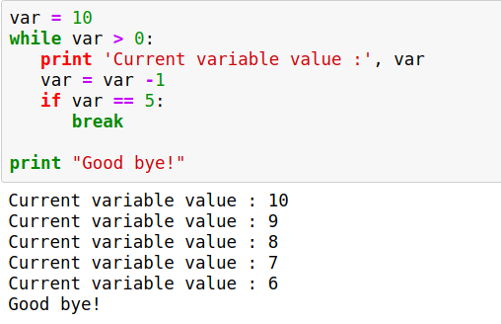
Loop Control: Break
For example, in the example, we can observe that values before 5 are not printed because of adding break.
Code:
Output:

Slide 65
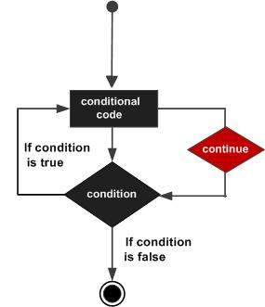
Loop Control: Continue
It returns the control to the beginning of the while loop.
Rejects all the remaining statements in the current iteration of the loop and moves the control back to the top of the loop.
Can be used in both while and for loops.

Slide 66
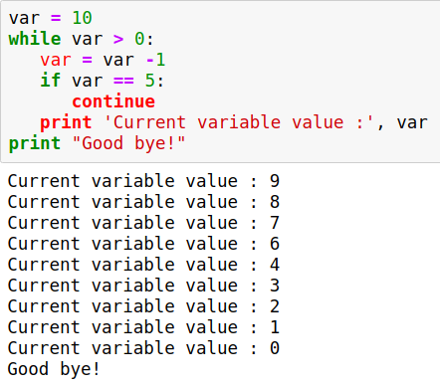
Loop Control: Continue
For example, in the given example, we can observe that values except 5 are printed.
Code:
Output:

Slide 67
Loop Control: Pass
The pass statement is a null operation; nothing happens when it executes.
The difference between a comment and pass statement in Python is that, while the interpreter ignores a comment entirely, pass is not ignored.

Slide 68
Why Pass statement?
Suppose we have a loop or a function that is not implemented yet, but we want to implement it in the future.
They cannot have an empty body. The interpreter would complain.
So, we use the pass statement to construct a body that does nothing.

Slide 69
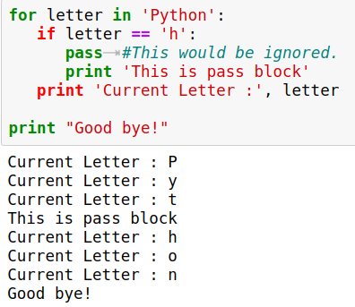
Loop Control: Continue
For example:
Code:
Output:

Slide 70
Non-Primitive Data Structures

Slide 71
Lists

Slide 72
Lists
Lists are the most versatile of Python's compound data types.
A list contains items separated by commas and enclosed within square brackets ([]).
One difference between lists and arrays is that all the items belonging to a list can be of different data type.

Slide 73
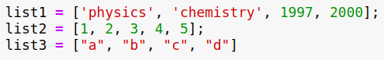
Creating a list
Creating a list is as simple as putting different comma-separated values between square brackets.
For example:

Slide 74
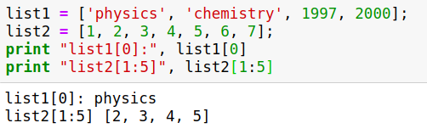
Accessing Values
To access values in lists, use the square brackets for slicing along with the index or indices to obtain value available at that index.
For Example:
Output:

Slide 75
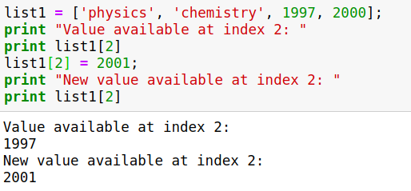
Updating Lists
You can update single or multiple elements of lists by giving the slice on the left-hand side of the assignment operator, and you can add to elements in a list with the append() method.
For Example:
Output:

Slide 76
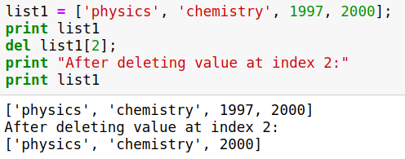
Delete List Elements
To remove a list element, you can use either the del statement if you know exactly which element(s) you are deleting or the remove() method if you do not know.
For Example:
Output:

Slide 77
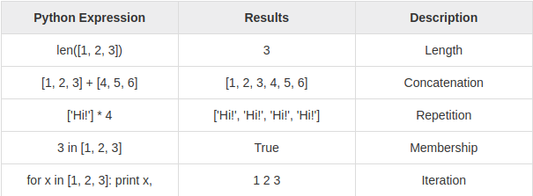
Basic List Operations
The operation type is specified in “Description” category.

Slide 78
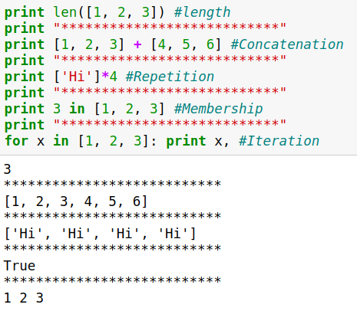
Basic List Operations - Example
Code:
Output:

Slide 79
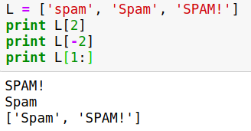
Indexing, Slicing, and Matrixes
Code:
Output:

Slide 80
Built-in List Functions
Python includes the following list functions
Compare | cmp(list1, list2) | Compares elements of both lists.
Length | len(list) | Gives the total length of the list.
Maximum | max(list) | Returns item from the list with max value.
Minimum | min(list) | Returns item from the list with min value.
List | list(seq) | Converts a tuple into list.

Slide 81
Compare Function - Algorithm
If elements are of the same type, perform the compare and return the result. If elements are different types, check to see if they are numbers.
If numbers, perform numeric coercion if necessary and compare.
If either element is a number, then the other element is "larger" (numbers are "smallest").
Otherwise, types are sorted alphabetically by name.
If we reached the end of one of the lists, the longer list is "larger." If we exhaust both lists and share the same data, the result is a tie, meaning that 0 is returned.

Slide 82
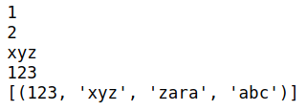
Built-in List Functions
If list1 = [123, 'xyz'], list2 = [456, 'abc'], and tupl = (123, 'xyz', 'zara', 'abc'),
Compare | cmp(list2, list1)
Length | len(list1)
Maximum | max(list1)
Minimum | min(list1)
List | list(tupl)

Slide 83
Built-in List Methods
Some of the built-in methods applies for lists are:
Append | list.append(obj) | Appends object obj to list
Count | list.count(obj) | Count of how many times obj occurs in list
Extend | list.extend(seq) | Appends the contents of seq to list
Remove | list.remove(obj) | Removes object obj from list
Insert | list.insert(index, obj) | Inserts object obj into list at offset index

Slide 84
List Comprehensions
List comprehensions are a unique way of quickly creating a list with Python.
Let’s see how we can divide a string into individual letters and store in a list.

Slide 85
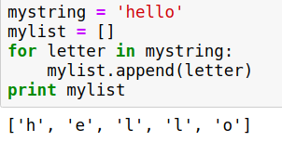
List Comprehensions - Example
For example,
Output:
By just a single line of code, we can form a list of letters in a string.

Slide 86
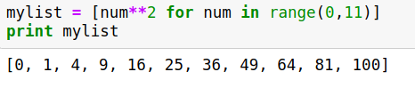
List Comprehensions - Example
To print the squares of the numbers from 0 to 10, we write the code as:
Code:
Output:
We can simply use the code mylist = [num for num in range(0,11) to print numbers from 0 to 10.

Slide 87
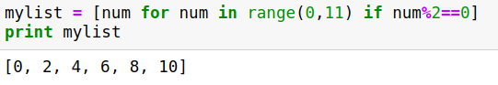
List Comprehensions - Example
We can also add if condition to the line.
For example, to print only even numbers from 0 to 10, we write the code as:
Code:
Output:
Similarly, we can also add else condition inside the logic.

Slide 88

List Comprehensions - Example
Let’s practice list comprehensions by doing celsius to fahrenheit conversion program.
Code:
Output:

Slide 89
List Comprehensions - Example
Let’s practice list comprehensions by doing celsius to fahrenheit conversion program.
Code:
Output:

Slide 90

Zip operator
Returns an iterator of tuples, where the i-th tuple contains the i-th element from each of the argument sequences or iterables.
The iterator stops when the shortest input iterable is exhausted.
For example,
Output:

Slide 91
Tuples

Slide 92

Tuples
A tuple is a sequence of immutable Python objects. Tuples are sequences, just like lists.
The differences between tuples and lists are, the tuples cannot be changed unlike lists and tuples use parentheses, whereas lists use square brackets.

Slide 93


Accessing Values in Tuples
To access values in tuple, use the square brackets for slicing along with the index or indices to obtain value available at that index.
For example:
Output:

Slide 94

Updation & Deletion of elements
Tuples are immutable which means you cannot update or change the values of tuple elements.
Let’s try to update first element with “new_value”.
Code:
Output:
Removing individual tuple elements is also not possible.

Slide 95

Basic Tuples Operations
Tuples respond to all of the general sequence operations we used on strings.

Slide 96
Built-in Tuple Functions
Python includes the following tuple functions:
Compare | cmp(tuple1, tuple2) | Compares elements of both tuples.
Length | len(tuple) | Gives the total length of the tuple.
Maximum | max(tuple) | Returns item from the tuple with max value.
Minimum | min(tuple) | Returns item from the tuple with min value.
Tuple | tuple(seq) | Converts a list into tuple.

Slide 97

Built-in Tuple Functions
If tuple1 =(123, 'xyz'), tuple2 = (456, 'abc'), and lst = [123, 'xyz', 'zara', 'abc'],
Compare | cmp(tuple1, tuple2)
Length | len(tuple1)
Maximum | max(tuple1)
Minimum | min(tuple1)
Tuple | tuple(lst)

Slide 98
Dictionaries

Slide 99
Dictionaries
Each key is separated from its value by a colon (:), the items are separated by commas, and the whole thing is enclosed in curly braces.
Keys are unique within a dictionary while values may not be. The values of a dictionary can be of any type, but the keys must be of an immutable data type such as strings, numbers, or tuples.

Slide 100


Accessing Values in Dictionary
To access dictionary elements, you can use the familiar square brackets along with the key to obtain its value.
Output:

Slide 101


Updating Dictionary
You can update a dictionary by adding a new entry or a key-value pair, modifying an existing entry, or deleting an existing entry
Output:

Slide 102
Built-in Dictionary Functions
cmp(dict1, dict2):
Compares elements of both dict.
len(dict):
Gives the total length of the dictionary. This would be equal to the number of items in the dictionary.
str(dict):
Produces a printable string representation of a dictionary
type(variable):
Returns the type of the passed variable. If passed variable is dictionary, then it would return a dictionary type.

Slide 103
Built-in Dictionary Methods
Some of the built-in methods are:
dict.clear()
dict.copy()
dict.fromkeys()
dict.get(key, default=None)
dict.has_key(key)
dict.items()
dict.keys()
dict.setdefault(key, default=None)
dict.update(dict2)
dict.values()

Slide 104

dict.keys() Method
Let’s see about dict.keys()
The method keys() returns a list of all the available keys in the dictionary
For example,
Output:
Similarly, dict.values() returns a list of all the available values, and dict.items() returns a list of key, value pairs.

Slide 105
Sets

Slide 106

Sets
Mathematically a set is a collection of items not in any particular order. A Python set is similar to this mathematical definition with below additional conditions.
The elements in the set cannot be duplicates.
The elements in the set are immutable(cannot be modified) but the set as a whole is mutable.
There is no index attached to any element in a python set. So they do not support any indexing or slicing operation.

Slide 107
Set Operations
The sets in python are typically used for mathematical operations like union, intersection, difference and complement etc.
We can create a set, access it’s elements and carry out these mathematical operations as shown further.

Slide 108

Creating a Set
A set is created by using the set() function or placing all the elements within a pair of curly braces.
Code:
Output:

Slide 109

Accessing Values in a Set
We cannot access individual values in a set. We can only access all the elements together as shown above. But we can also get a list of individual elements by looping through the set.
Code:
Output:

Slide 110

Set Operations
DaysA=set(["Mon", "Tue", "Wed", "Thu", "Fri"])
DaysB=set([“Sun”, “Sat”])
Adding items to a Set: DaysA.add("Sun")

Slide 111
Set Operations
Similarly, for Removing Item from a Set: DaysA.discard("Sun") and
Union of 2 Sets: DaysA|DaysB or DaysA.union(DaysB)
Intersection of Sets: DaysA & DaysB or DaysA.intersection(DaysB)
Difference of Sets: DaysA - DaysB or DaysA.difference(DaysB)
Comparing Sets: DaysA.issubset(DaysB), DaysA.issuperset(DaysB)

Slide 112
Functions

Slide 113

Function
A function is a block of organized, reusable code that is used to perform a single, related action.
Functions provide better modularity for your application and a high degree of code reusing.
Python gives you many built-in functions like print(), etc. but you can also create your own functions. These functions are called user-defined functions.

Slide 114
Rules to Define a Function
Function blocks begin with the keyword def followed by the function name and parentheses ( ( ) ).
Any input parameters or arguments should be placed within these parentheses. You can also define parameters inside these parentheses.
The first statement of a function can be an optional statement - the documentation string of the function or docstring.

Slide 115

Docstring
Python documentation strings (or docstrings) provide a convenient way of associating documentation with Python modules, functions, classes, and methods.
For example,

Slide 116
Rules to Define a Function
The code block within every function starts with a colon (:) and is indented.
The statement return [expression] exits a function, optionally passing back an expression to the caller. A return statement with no arguments is the same as return None.

Slide 117


Syntax
By default, parameters have a positional behavior and we need to inform them in the same order that they were defined.

Slide 118


Example
The given function takes a string as input parameter and prints it on standard screen.
Output:

Slide 119
Pass by reference vs value
All parameters (arguments) in the Python language are passed by reference. It means if you change what a parameter refers to within a function, the change also reflects back in the calling function.

Slide 120

Pass by reference vs value
For Example,
Here, we are maintaining reference of the passed object and appending values in the same object.
Output:

Slide 121

Pass by reference vs value
There is one more example where argument is being passed by reference and the reference is being overwritten inside the called function.

Slide 122
Pass by reference vs value
The parameter mylist is local to the function changeme.
Changing mylist within the function does not affect mylist.
The function accomplishes nothing and finally this would produce the following result.
Output:

Slide 123
Function Arguments
You can call a function by using the following types of formal arguments −
Required arguments
Keyword arguments
Default arguments
Variable-length arguments

Slide 124

Required Arguments
Required arguments are the arguments passed to a function in correct positional order. Here, the number of arguments in the function call should match exactly with the function definition.
For Example,

Slide 125

Keyword Arguments
Keyword arguments are related to the function calls. When you use keyword arguments in a function call, the caller identifies the arguments by the parameter name.
This allows you to skip arguments or place them out of order because the Python interpreter is able to use the keywords provided to match the values with parameters.

Slide 126

Keyword Arguments - Example
Output:
Note that the order of parameters does not matter.

Slide 127

Default Arguments
A default argument is an argument that assumes a default value if a value is not provided in the function call for that argument.
For Example,
Output:

Slide 128

Variable-length Arguments
You may need to process a function for more arguments than you specified while defining the function. These arguments are called variable-length arguments and are not named in the function definition, unlike required and default arguments.
Syntax for a function with non-keyword variable arguments is this

Slide 129

Variable-length Arguments
For example, let’s add a list of arguments for sum operation.
Code:
Output:

Slide 130
*args & **kwargs
*args and **kwargs are mostly used in function definitions. *args and **kwargs allow you to pass a variable number of arguments to a function.
What does variable mean here is that you do not know before-hand that how many arguments can be passed to your function by the user so in this case you use these two keywords.

Slide 131

*args Example
*args is used to send a non-keyworded variable length argument list to the function.
Code:
Output:

Slide 132

**kwargs Example
**kwargs allows you to pass keyworded variable length of arguments to a function.
You should use **kwargs if you want to handle named arguments in a function.
Code:
Output:
If you want to use all three of these(*args, **kwargs, formal args) in function, the order is:
some_func(fargs, *args, **kwargs)

Slide 133
Scope of Variables
All variables in a program may not be accessible at all locations in that program. This depends on where you have declared a variable.
The scope of a variable determines the portion of the program where you can access a particular identifier. There are two basic scopes of variables in Python −
Global variables
Local variables

Slide 134
Global vs. Local variables
Variables that are defined inside a function body have a local scope, and those defined outside have a global scope.
This means that local variables can be accessed only inside the function in which they are declared, whereas global variables can be accessed throughout the program body by all functions.
When you call a function, the variables declared inside it are brought into scope.

Slide 135

Global vs. Local variables

Slide 136

Global vs. Local variables - Example
Let’s see an Example.
Code:
Output:

Slide 137
Classes/Objects

Slide 138

Class
A user-defined prototype for an object that defines a set of attributes that characterize any object of the class.
The attributes are data members (class variables and instance variables) and methods, accessed via dot notation.

Slide 139

Class

Slide 140

Creating a Class
The class statement creates a new class definition. The name of the class immediately follows the keyword class.
Syntax:
The class has a documentation string, which can be accessed via ClassName.__doc__.
The class_suite consists of all the component statements defining class members, data attributes and functions.

Slide 141

Creating a Class - Example
The variable empCount is a class variable whose value is shared among all instances of a this class. This can be accessed as Employee.empCount from inside the class or outside the class.

Slide 142
Creating a Class - Example
The first method __init__() is a special method, which is called class constructor or initialization method that Python calls when you create a new instance of this class.

Slide 143
Creating a Class - Example
You declare other class methods like normal functions with the exception that the first argument to each method is self.
Python adds the self argument to the list for you; you do not need to include it when you call the methods.

Slide 144
Object
Python has been an object-oriented language since it existed.
A unique instance of a data structure that's defined by its class.
An object comprises both data members (class variables and instance variables) and methods.

Slide 145

Creating Instance Objects
To create instances of a class, you call the class using class name and pass in whatever arguments its __init__ method accepts.

Slide 146

Accessing Attributes
You access the object's attributes using the dot operator with object. Class variable would be accessed using class name.

Slide 147

Example
Let’s try an example to understand it better.

Slide 148

Example
The output for the code is:

Slide 149

Class Inheritance
Instead of starting from scratch, you can create a class by deriving it from a preexisting class by listing the parent class in parentheses after the new class name.
The child class inherits the attributes of its parent class.

Slide 150

Class Inheritance
Notes:
It is a technique of building new classes called derived classes from the existing class called a base class by inheriting the features of the base class. The features include different attributes and behavioral methods.
For example, if the vehicle is the parent class, then cars, buses, and trucks are the derived classes which have inherited all the features of parent class vehicle with many more additional features as well.

Slide 151

Class Inheritance - Example
Example:

Slide 152

Class Inheritance - Example
When the code is executed, it produces the following result:

Slide 153


Overriding Methods
You can always override your parent class methods.
One reason for overriding parent's methods is because you may want special or different functionality in your subclass.
Example:
Output:

Slide 154
Method Types

Slide 155

Method Types
A method is a function that is stored as a class attribute.
Method Types:
Instance Methods
Class Methods
Static Methods

Slide 156

Instance Method
The first method on MyFunctions, called method, is a regular instance method.
That’s the basic, no-frills method type you’ll use most of the time.
You can see the method takes one parameter, self, which points to an instance of MyClass when the method is called.

Slide 157

Instance Method - Example
Through the self parameter, instance methods can freely access attributes and other methods on the same object.
Example:
Code:
Output:

Slide 158
Static Method
Transforming a method into a static method:
A static method does not receive an implicit first argument.
To declare a static method, use this decorator: @staticmethod

Slide 159

Static Method - Example
For example:
You can access the methods in class with class_name.attribute_name().
In the given code: MyFunctions.variable_1

Slide 160
Static Method - Example
For the discussed code, the command:
MyFunctions.func2() which will return variable_1 value defined in MyFunctions class.
Code:
Output:

Slide 161
Class Method
Transforming a method into a class method:
A class method receives the class as implicit first argument, just like an instance method receives the instance.
To declare a class method, use this decorator: @classmethod

Slide 162
Class Method
Instead of accepting a self parameter, class methods take a cls parameter that points to the class—and not the object instance—when the method is called.
Simply, Class methods are methods that are not bound to an object, but to a class.

Slide 163
Class Method - Example
You can access the class attributes inside the method using cls.attribute_name.
For example, in the code, cls.variable_1.
When you type the command MyFunctions.func3(), it will return variable_1 value.
Output:

Slide 164
Regular Expressions

Slide 165

Regular Expressions
Simply put, regular expression is a sequence of character(s) mainly used to find and replace patterns in a string or file.
Sometimes shortened to regexp, regex, or re are a tool for matching patterns in text.
In Python, we have the re module.

Slide 166
Regular Expressions
Regular expressions use two types of characters:
Meta characters:
As the name suggests, these characters have a special meaning, similar to * in wild card.
Literals (like a,b,1,2…)

Slide 167
Regular Expressions in Python
In Python, we have module “re” that helps with regular expressions.
So you need to import library re before you can use regular expressions in Python.
import re

Slide 168
Regular Expressions in Python
The most common uses of regular expressions are:
Search a string (search and match)
Finding a string (findall)
Break string into a sub strings (split)
Replace part of a string (sub)
The re module provides a plethora of methods to achieve these uses.
Notes:
To understand this, let’s take a scenario.

Slide 169
Methods of Regular Expressions
The ‘re’ package provides multiple methods to perform queries on an input string. Here are the most commonly used methods:
re.match()
re.search()
re.findall()
re.split()
re.sub()
re.compile()
Notes:
But a small thing first: There are various characters, which would have special meaning when they are used in regular expression. To avoid any confusion while dealing with regular expressions, we would use Raw Strings as r'expression'.

Slide 170
The match Function
re.match()
This function attempts to match RE pattern to string with optional flags.
Here is the syntax for this function
re.match(pattern, string, flags=0)
This method finds match if it occurs at start of the string.
For example, calling match() on the string ‘AV Analytics AV’ and looking for a pattern ‘AV’ will match. However, if we look for only Analytics, the pattern will not match. Let’s perform it in python now.
Notes:
To understand this, let’s take a scenario.

Slide 171
The match Function
Match Object Method | Description
group(num=0) | This method returns entire match (or specific subgroup num)
groups() | This method returns all matching subgroups in a tuple (empty if there weren't any)
The re.match function returns a match object on success, None on failure.
We use group(num) or groups() function of match object to get matched expression.
Notes:
To understand this, let’s take a scenario.

Slide 172
The match Function
Code:
import re
result = re.match(r'AV', 'AV Analytics Vellore AV')
print result
The output shows that the pattern match has been found.
Notes:
Above, it shows that pattern match has been found.

Slide 173

The match Function
Code:
import re
result = re.match(r'AV', 'AV Analytics Vellore AV')
print result.group(0)
To print the matching string we’ll use method group (It helps to return the matching string).
Use “r” at the start of the pattern string, it designates a python raw string.
Let’s now find ‘Analytics’ in the given string.

Slide 174

The match Function
Code:
import re
result = re.match(r'Analytics', 'AV Analytics Vellore AV')
print result.group(0)
Observe that the string is not starting with ‘AV’ so it should return no match.

Slide 175

The start() and end() functions
Code:
import re
result = re.match(r'AV', 'AV Analytics Vellore AV')
print "result.start=\t", result.start()
print "result.end=\t",result.end()
There are methods like start() and end() to know the start and end position of matching pattern in the string
Notes:
Above you can see that start and end position of matching pattern ‘AV’ in the string and sometime it helps a lot while performing manipulation with the string.

Slide 176
The search Function
re.search()
This function searches for first occurrence of RE pattern within string with optional flags.
Here is the syntax for this function
re.search(pattern, string, flags=0)
It is similar to match() but it doesn’t restrict us to find matches at the beginning of the string only.
Unlike previous method, here searching for pattern ‘Analytics’ will return a match.
Notes:
To understand this, let’s take a scenario.

Slide 177

The search Function
For example:
import re
result = re.search(r'Analytics', 'AV Analytics Vellore AV')
print "\nMatch found"
print result.group(0)
Here you can see that, search() method is able to find a pattern from any position of the string but it only returns the first occurrence of the search pattern.
Notes:
To understand this, let’s take a scenario.

Slide 178
The findall Function
re.findall()
It helps to get a list of all matching patterns.
It has no constraints of searching from start or end. If we will use method findall to search ‘AV’ in given string it will return both occurrence of AV.
Here is the syntax for this function
re.search(pattern, string, flags=0)
Notes:
To understand this, let’s take a scenario.

Slide 179

The findall Function
Code:
import re
result = re.findall(r'AV', 'AV Analytics Vellore AV')
print "\nMatch found"
print result

Slide 180
The split Function
re.split()
This methods helps to split string by the occurrences of given pattern.
Here is the syntax for this function
re.split(pattern, string, [maxsplit=0]):
Notes:
To understand this, let’s take a scenario.

Slide 181

The split Function
Code:
import re
result = re.split(r'e', 'Campfire Athletics')
print result
The program splits the string based on the regular expression selected.

Slide 182

The split Function
Code:
import re
result = re.split(r'e', 'Campfire Athletics', maxsplit=1)
print result
Method split() has another argument “maxsplit“. It has default value of zero. In this case it does the maximum splits that can be done, but if we give value to maxsplit, it will split the string.
notice that we have fixed the maxsplit to 1. And the result is, it has only two values whereas first example has three values.

Slide 183
The substitute Function
re.sub()
It helps to search a pattern and replace with a new sub string.
If the pattern is not found, string is returned unchanged.
Here is the syntax for this function
re.sub(pattern, repl, string)
Notes:
To understand this, let’s take a scenario.

Slide 184

The substitute Function
Code:
import re
result = re.split(r'India','the World','AV is largest Analytics community of India')
print "\nString substituted by pattern:"
print result

Slide 185
The compile Function
re.compile()
We can combine a regular expression pattern into pattern objects, which can be used for pattern matching. It also helps to search a pattern again without rewriting it.
Here is the syntax for this function
re.compile(pattern, repl, string)
Notes:
To understand this, let’s take a scenario.

Slide 186

The compile Function
import re
pattern=re.compile('AV')
result=pattern.findall('AV Analytics Vellore AV')
print "\n String 1 with compiled pattern"
print result
result2=pattern.findall('AV is largest analytics community of India')
print "\n String 2 with compiled pattern"
print result2

Slide 187
Commonly used operators
Regular expressions can specify patterns, not just fixed characters. Here are the most commonly used operators that helps to generate an expression to represent required characters in a string or file.
Operators | Description
. | Matches with any single character except newline ‘\n’.
? | match 0 or 1 occurrence of the pattern to its left
+ | 1 or more occurrences of the pattern to its left
* | 0 or more occurrences of the pattern to its left
\w | Matches with a alphanumeric character whereas \W (upper case W) matches non alphanumeric character.
\d | Matches with digits [0-9] and /D (upper case D) matches with non-digits.
Notes:
http://techtales.co/2017/09/05/dynamic-typing-vs-static-typing-mean/

Slide 188
Commonly used operators
Operators | Description
\s | Matches with a single white space character (space, newline, return, tab, form) and \S (upper case S) matches any non-white space character.
\b | boundary between word and non-word and /B is opposite of /b
[..] | Matches any single character in a square bracket and [^..] matches any single character not in square bracket
\ | It is used for special meaning characters like \. to match a period or \+ for plus sign.
\b | boundary between word and non-word and /B is opposite of /b
Notes:
http://techtales.co/2017/09/05/dynamic-typing-vs-static-typing-mean/

Slide 189
Commonly used operators
Operators | Description
^ and $ | ^ and $ match the start or end of the string respectively
{n,m} | Matches at least n and at most m occurrences of preceding expression if we write it as {,m} then it will return at least any minimum occurrence to max m preceding expression.
a| b | Matches either a or b
( ) | Groups regular expressions and returns matched text
\t, \n, \r | Matches tab, newline, return
Notes:
http://techtales.co/2017/09/05/dynamic-typing-vs-static-typing-mean/

Slide 190
Some Examples of Regular Expressions

Slide 191

Extract each word (using “*” or “+“)
import re
result=re.findall(r'\w*','The Sun Rises In the East')
print "\nExtracted words:"
print result

Slide 192

Return the domain type of given email-ids
import re
result=re.findall(r'@\w+.\w+','abc.test@gmail.com, xyz@test.in, test.first@google.com, first.test@rest.biz')
print "\nExtracted Email Domains:"
print result

Slide 193

Return date from given string
import re
result=re.findall(r'\d{2}-\d{2}-\d{4}','Amit 34-3456 12-05-2007, XYZ 56-4532 11-11-2011, ABC 67-8945 12-01-2009')
print "\nExtracted Dates:"
print result

Slide 194
Lambda Functions

Slide 195
Lambda Functions
lambda operator or lambda function is a way to create small anonymous functions, i.e. functions without a name.
These functions are throw-away functions, i.e. they are just needed where they have been created.
Syntax:

Slide 196
Lambda Operator
lambda operator can have any number of arguments, but it can have only one expression.
It cannot contain any statements and it returns a function object which can be assigned to any variable.

Slide 197

Lambda Operator - Example
Function in Python:
The function defined above is add,
it expects two arguments x and y and returns their sum.
Let’s see how we can convert the above function into a lambda function.

Slide 198

Lambda Operator - Example
“Add” function using lambda:
In lambda x, y: x + y; x and y are arguments to the function, and
x + y is the expression which gets executed and its values is returned as output.
If we check the type of add, with type(add) command, it’s a function.

Slide 199
Lambda functions
Mostly lambda functions are passed as parameters to a function which expects a function objects as parameter like map, reduce, filter functions.

Slide 200
map function
map functions expects a function object and any number of iterables like list, dictionary, etc.
It executes the function_object for each element in the sequence and returns a list of the elements modified by the function object.
Basic Syntax:

Slide 201

map function - Example
In the given example, map executes multiply2 function for each element in the list i.e. 1, 2, 3, 4 and returns [2, 4, 6, 8]
Code:
Output:
Let’s see how we can write the above code using map and lambda.

Slide 202

map funtion - Example
Just one line of code:
Output:

Slide 203

Multiple iterables to the map function
We can pass multiple sequences to the map functions as shown below:
Here, each i^th element of list_a and list_b will be passed as argument to the lambda function.
Output:

Slide 204
filter function
filter function expects two arguments:
function_object and
an iterable.
function_object returns a boolean value.
function_object is called for each element of the iterable and filter returns only those element for which the function_object returns true.

Slide 205
filter function
Like map function, filter function also returns a list of element.
Unlike map function filter function can only have one iterable as input.
Basic Syntax:

Slide 206

filter function - Example
Even number using filter function:
Output:

Slide 207

Filter list of dicts
Filtering list of dicts using filter
Output:

Slide 208
Reducing a List
The function reduce(func, seq) continually applies the function func() to the sequence seq. It returns a single value.
If seq = [ s1, s2, s3, ... , sn ], calling reduce(func, seq) works like this:
At first the first two elements of seq will be applied to func, i.e. func(s1,s2) The list on which reduce() works looks now like this: [ func(s1, s2), s3, ... , sn ]
In the next step func will be applied on the previous result and the third element of the list, i.e. func(func(s1, s2),s3)
The list looks like this now: [ func(func(s1, s2),s3), ... , sn ]
Continue like this until just one element is left and return this element as the result of reduce()

Slide 209

Reducing a List
reduce(lambda x,y: x+y, [47,11,42,13])
The following diagram shows the intermediate steps of the calculation:

Slide 210

Examples of reduce()
Determining the maximum of a list of numerical values by using reduce:
Output:
Calculating the sum of the numbers from 1 to 100:
Output:

Slide 211
Python Documentation
To learn more about Python, or for any queries you can refer python documentation.
Ref: https://docs.python.org/3/

Slide 212
END

Slide 213
Arrays

Slide 214
Arrays
Array is a container which can hold a fix number of items and these items should be of the same type.
Element− Each item stored in an array is called an element.
Index − Each location of an element in an array has a numerical index, which is used to identify the element.

Slide 215

Arrays
Array is created in Python by importing array module to the python program. Then the array is declared as shown.

Slide 216

Creating an Array
The given code creates an array named array1.

Slide 217

Accessing Array Element
We can access each element of an array using the index of the element.
For example, when we execute the given code, the output is:

Slide 218


Insertion
Insert operation is to insert one or more data elements into an array.
Here, let’s add a data element at the middle of the array using the python in-built insert() method.
When we execute the following code,

Slide 219


Deletion
Deletion refers to removing an existing element from the array and re-organizing all elements of an array.
Here, let’s remove a data element at the middle of the array using the python in-built remove() method.
Output:

Slide 220

Searching an element
We can perform a search for an array element based on its value or its index.
Here, let’s search a data element using the python in-built index() method.
When we compile and execute the above program, it produces the following result which shows the index of the element. If the value is not present in the array then the program returns an error.

Slide 221


Updation
Update operation refers to updating an existing element from the array at a given index.
Here, we simply reassign a new value to the desired index we want to update.
Output:

Slide 222
Files I/O

Slide 223

The raw_input Function
It is a built-in function to read a line of text from standard input, which by default comes from the keyboard. It reads one line from standard input and returns it as a string.
For example,
Output

Slide 224

Creating a file in Jupyter
You can create a file in Jupyter with code:
Output:
Note: This codes only works in Jupyter. If you want to create in any editor, you can directly create it by adding the text inside the file.

Slide 225
Files
Until now, you have been reading and writing to the standard input and output. Now, we will see how to use actual data files.
Python provides basic functions and methods necessary to manipulate files by default. You can do most of the file manipulation using a file object.

Slide 226
The open Funtion
Before you can read or write a file, you have to open it using Python's built-in open() function.
This function creates a file object, which would be utilized to call other support methods associated with it.
Syntax: file object = open(file_name [, access_mode][, buffering])

Slide 227
The open Funtion
Syntax: file object = open(file_name [, access_mode][, buffering])
file_name − String value that contains the name of the file that you want to access.
access_mode − The mode in which the file has to be opened, i.e., read, write, append, etc. This is optional parameter and the default file access mode is read (r).

Slide 228
The open Funtion
Syntax: file object = open(file_name [, access_mode][, buffering])
buffering −
If the buffering value is set to 0, no buffering takes place.
If the buffering value is 1, line buffering is performed while accessing a file.
If you specify the buffering value as an integer greater than 1, then buffering action is performed with the indicated buffer size.
If negative, the buffer size is the system default(default behavior).

Slide 229
The file Object Attributes
Once a file is opened and you have one file object, you can get various information related to that file.
file.closed: Returns true if file is closed, false otherwise.
file.mode: Returns access mode with which file was opened.
file.name: Returns name of the file.
file.softspace: Returns false if space explicitly required with print, true otherwise.

Slide 230
The file Object Attributes - Example
Once a file is opened and you have one file object, you can get various information related to that file.
file.closed: Returns true if file is closed, false otherwise.
file.mode: Returns access mode with which file was opened.
file.name: Returns name of the file.
file.softspace: Returns false if space explicitly required with print, true otherwise.

Slide 231
Date & Time

Slide 232
Date & Time
A Python program can handle date and time in several ways. Converting between date formats is a common chore for computers.
Python's time and calendar modules help track dates and times.

Slide 233
The time Module
There is a popular time module available in Python which provides functions for working with times and for converting between representations.
Let’s see some examples.

Slide 234
Time Tuple
Many of Python's time functions handle time as a tuple of 9 numbers.
Index | Field | Values
0 | 4-digit year | 2018
1 | Month | 1 to 12
2 | Day | 1 to 31
3 | Hour | 0 to 23
4 | Minute | 0 to 59
5 | Second | 0 to 61 (60 or 61 are leap-seconds)
6 | Day of Week | 0 to 6 (0 is Monday)
7 | Day of year | 1 to 366 (Julian day)
8 | Daylight savings | -1, 0, 1, -1 means library determines DST

Slide 235

Getting Current Time
To translate a time instant from a seconds since the epoch floating-point value into a time-tuple, pass the floating-point value to a function (e.g., localtime) that returns a time-tuple with all nine items valid.
For example,
Output:

Slide 236
Formatting Time
You can format any time as per your requirement, but one simple method to get time in readable format is asctime()

Slide 237

Getting formatted time
Code:
Output:

Slide 238

Calendar for a Month
The calendar module gives a wide range of methods to play with yearly and monthly calendars. Here, we print a calendar for a given month ( Jan 2018 )
Code: Output:

